Slide 1
Enhancing Sentiment Analysis of Romanized Code- Mixed Nepali Social Media Text Through Monolingual Transformation
Safal Sharma
Computer Engineering
Gandaki College of Engineering and Science
Pokhara, Nepal
be2022ce162@gces.edu.np
Apar Poudel
Computer Engineering
Gandaki College of Engineering and Science
Pokhara, Nepal
be2022ce161@gces.edu.np
Dr. Bidur Devkota
associate professor
Gandaki College of
Engineering and Science
Pokhara, Nepal
bidur@gces.edu.np

Slide 2
What is sentiment analysis?
Sentiment analysis is a process that uses natural language processing (NLP) and machine learning to identify and categorize the underlying emotional tone of a piece of text.
Practical Importance: Accurately evaluating sentiment in social media text provides crucial insights into public opinion and serves as a foundational step for broader NLP applications, such as the identification of online hate speech and the analysis of diverse regional dialects
Challenges Faced in Code-Mixed Languages
Lack of Standardized Orthography
Noise, Casual Slang, and Idioms
Inherent word-sense ambiguity
Noise, Casual Slang, and Idioms
The Rise of Romanized Script Usage and Its Impact on Transformer Models
While Romanized Nepali has become the dominant script for communication on social media platforms in Nepal, where popular transformer-based encoding models such as XLM-RoBERTa, mBERT, and MuRIL struggle with raw Romanized input and code-switching noise

Slide 3
How are social media texts?
vanja ta hero hudo raixa
yo kukur lai nxodnu dd
india ko rajkot bata herxu regular
news the very best

Slide 4
Objectives of the Study
Address the Script Gap Between Romanized Text and Formal Devanagari Models
Propose a Parallel Normalization Strategy for Better Sentiment Classification
Evaluate Performance Gains Using Monolingual Transformation

Slide 5
Related Works
Authors | Title
Pahari & Shimada (2023) | Language Preference for Expression of Sentiment for Nepali-English Bilingual Speakers on Social Media
Gupta, Joshi, & Bali (2020) | To Convert or Not to Convert: Back-Transliteration of Code-Mixed Text for Downstream NLP
Singh, Sen, & Kumar (2018) | A Twitter Sentiment Analysis Approach for Romanized Code-Mixed Hindi-English Text using Machine Translation
Joshi et al. (2016) | Towards Sub-word Level Language Identification for Intra-word Code-Switching in Hindi-English
Khanuja et al. (2021) | MuRIL: Multilingual Representations for Indian Languages
Conneau et al. (2020) | Unsupervised Cross-lingual Representation Learning at Scale (XLM-RoBERTa)
Winata et al. (2021) | Are Multilingual Models Effective in Code-Switching?
Adhikari et al. (2022) | COVID-19-Related Nepali Tweets Classification in a Low Resource Setting
Patwa et al. (2020) | SemEval-2020 Task 9: Overview of Sentiment Analysis of Code-Mixed Tweets
Gurung (2019) | Nepali-English Code-Switching in the Conversations of Nepalese People: A Sociolinguistic Study

Slide 6
Dataset Overview
The base corpus consists of 10,702 comments collected from YouTube (Pahari & Shimada).
Raw Text Format: The comments existed in raw Romanized script, containing non-standardized orthography, code-mixed Nepali-English phrases, and casual social media noise.
Each instance was annotated into one of three core sentiment categories: Positive, Neutral, or Negative
The base corpus is well-balanced across all three classes, preventing model bias toward any single sentiment category:
Positive: 3,460 comments (~32.3%)
Neutral: 3,648 comments (~34.1%)
Negative: 3,594 comments (~33.6%)
1079 committed were used for validation, and 1069 were used for the testing.

Slide 7
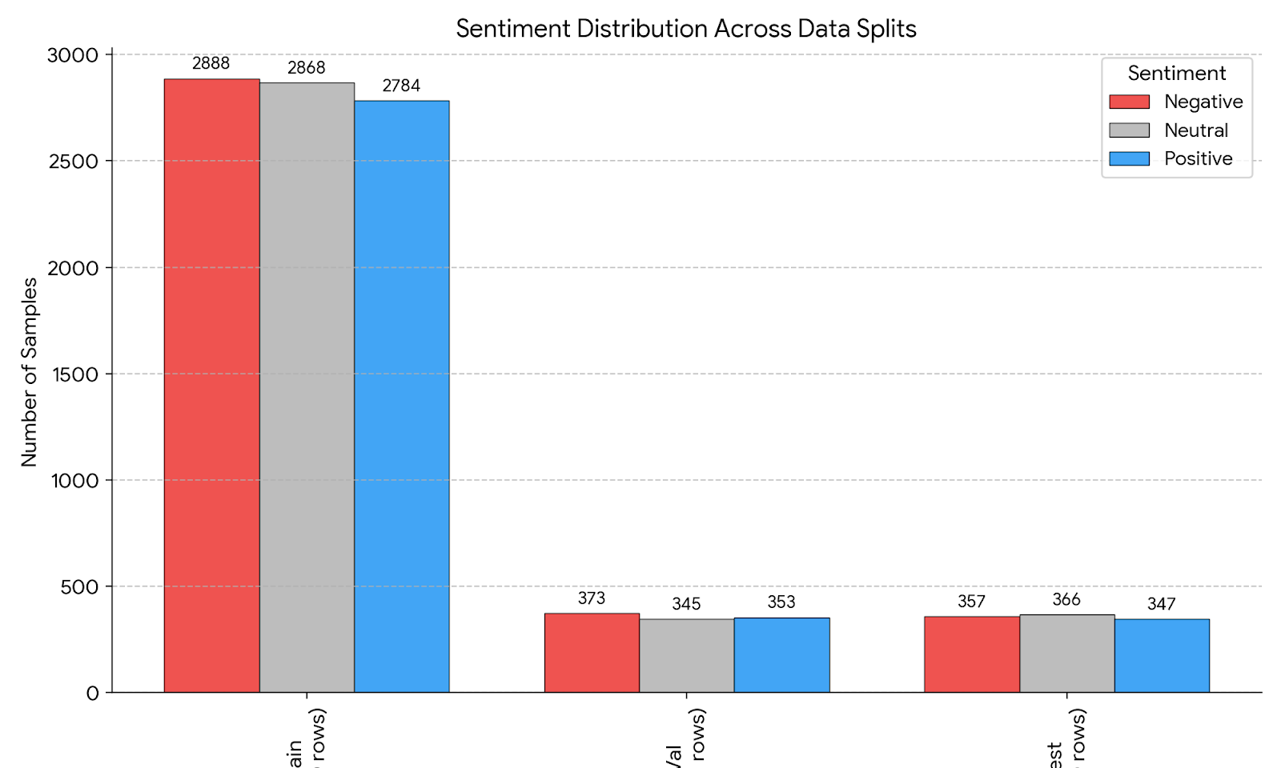
Distribution of details
Train: Negative (33.8%), Neutral (33.6%), Positive (32.6%)
Val: Negative (34.8%), Neutral (32.2%), Positive (33.0%)
Test: Negative (33.4%), Neutral (34.2%), Positive (32.4%)

Slide 8
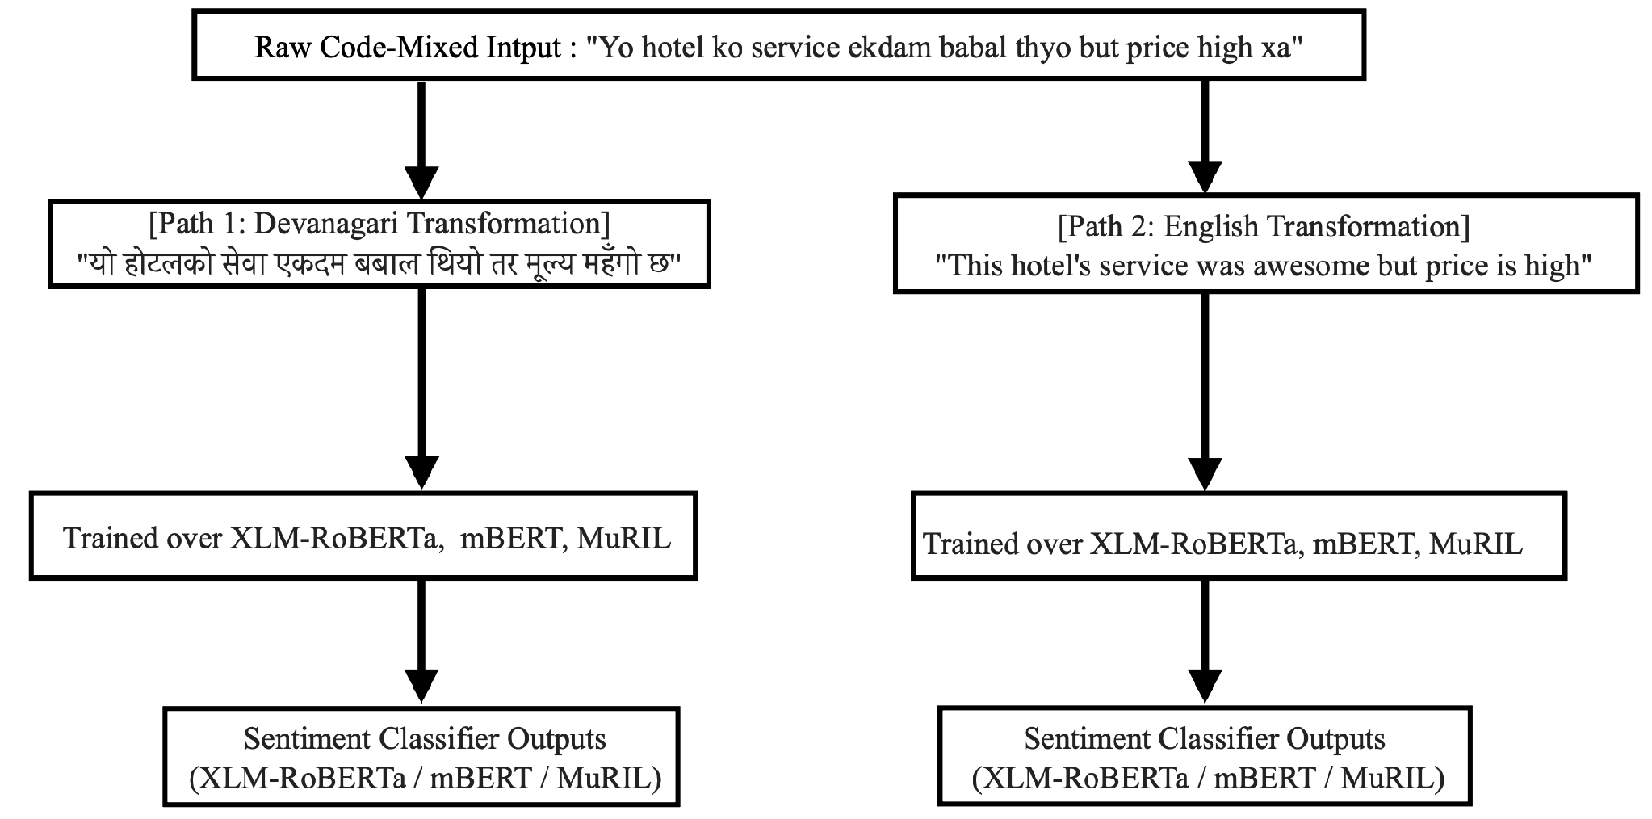
What we did ?

Slide 9
Transformer Model Architectures Overview
mBERT (Multilingual BERT): A multilingual transformer-based encoding model pre-trained on Wikipedia dumps across 104 languages using Masked Language Modeling (MLM).
Role in Experiment: Provides a baseline for multilingual representations, though performance on raw Romanized text is hindered by out-of-vocabulary tokens and informal code-switching noise
XLM-RoBERTa: A large-scale multilingual transformer model trained on over 2.5 TB of filtered Common Crawl data across 100 languages, utilizing an optimized RoBERTa pre-training approach.
Role in Experiment: Emerged as the top-performing model in the evaluation . Standardizing inputs to Devanagari allowed XLM-RoBERTa to overcome the "script gap," increasing its Macro F1 score from 0.67 on raw Romanized text to 0.7093 on normalized Devanagari

Slide 10
MuRIL:A pre-trained transformer model specifically engineered for Indic languages, trained on both monolingual and translated/transliterated parallel corpora from South Asian languages.
Role in Experiment: Specifically suited for Devanagari and regional linguistic patterns. Script normalization yielded similar performance gains for MuRIL by eliminating raw transliteration noise and aligning text with its Indic training representations

Slide 11
Experimental Setup
Transformer Architectures
Models:
mBERT: Wikipedia pre-trained
XLM-RoBERTa: CommonCrawl pre-trained
MuRIL: Indic-focused pre-trained
Training Hyperparameters & Evaluation Protocol
Training Configuration:
Optimizer: AdamW
Learning Rate: 1 * 10^-5
Epochs: 5 epochs

Slide 12
Evaluation Metrics:
Per-class F1 (Positive, Neutral, Negative), Macro F1, Weighted F1, and Accuracy

Slide 13
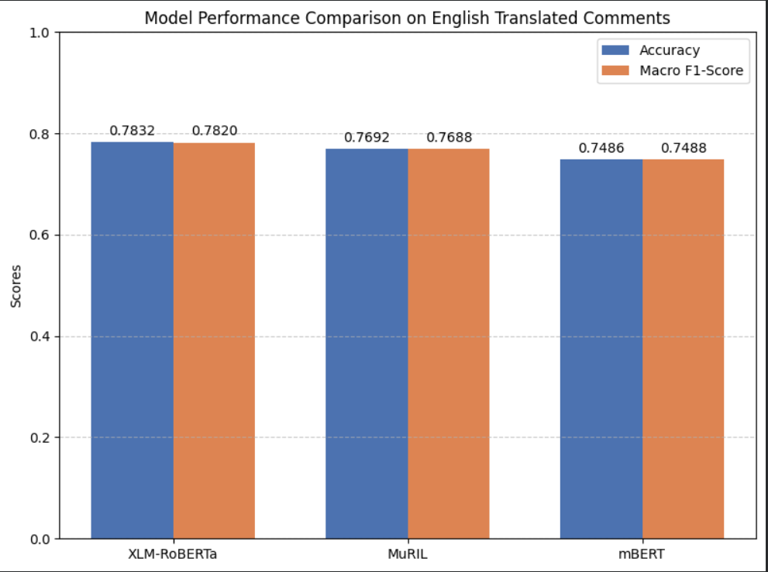
English Translation Result

Slide 14
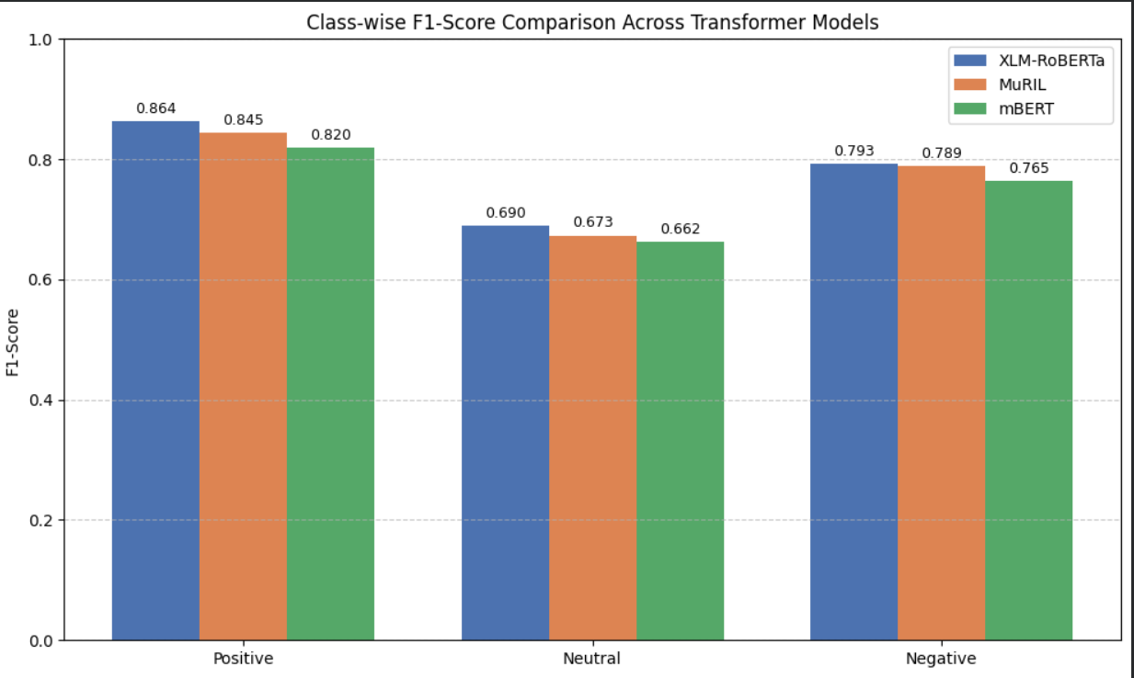

Slide 15
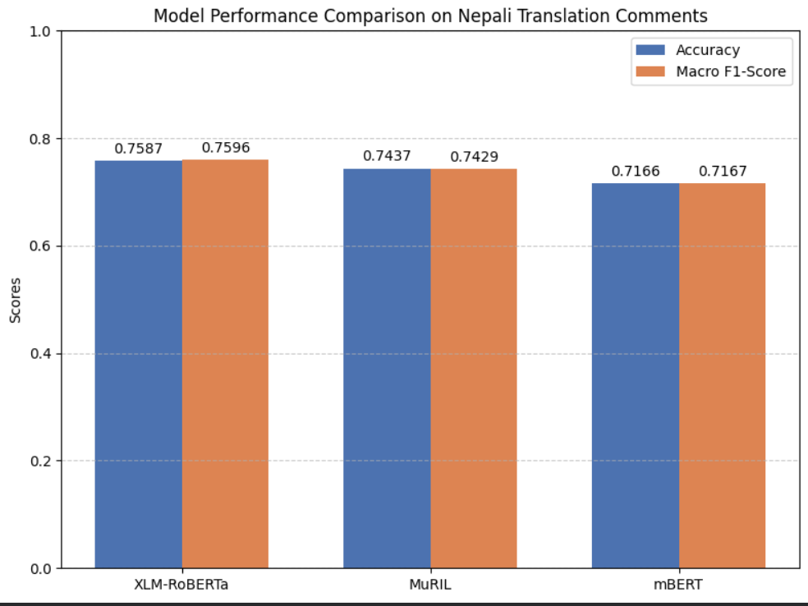
Nepali Translation Result

Slide 16
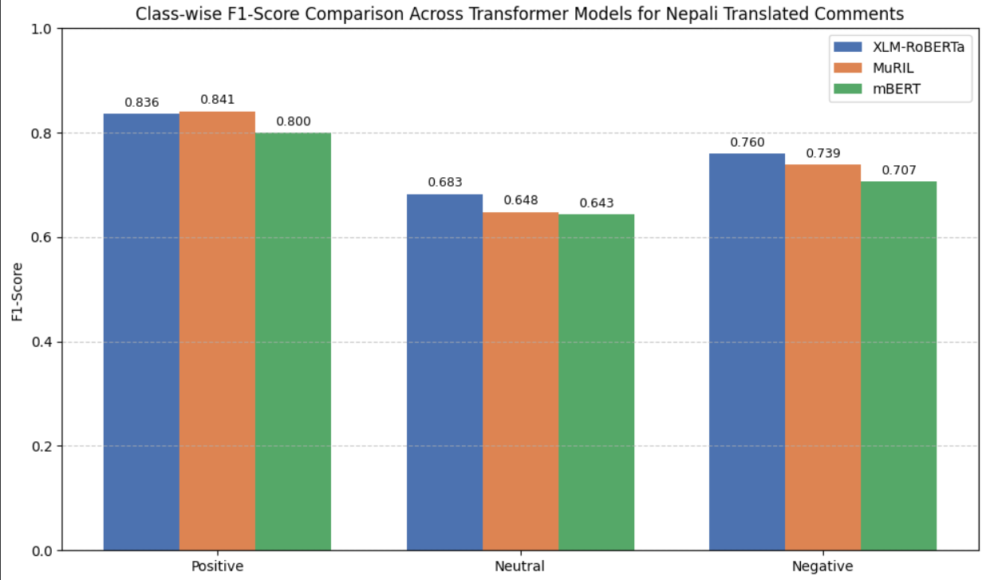

Slide 17
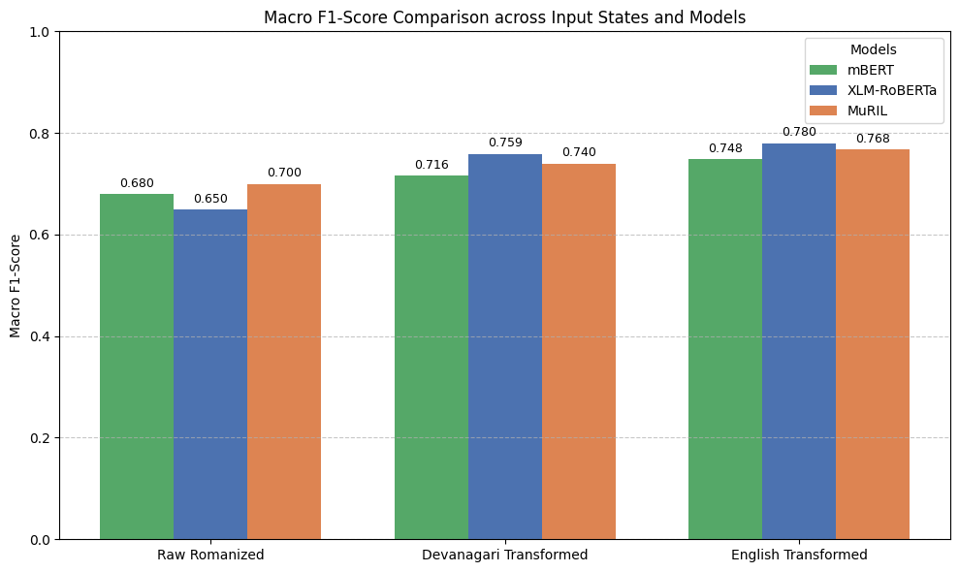
Model’s Comparison With the Base Paper

Slide 18
Limitation of the Study
Semantic Ambiguity & Neutral Class Difficulties: Neutral posts often lack strong polarity markers, making them harder for transformer models to separate from subtle positive or negative tones.
Contextual Nuances Unresolved by Normalization: While structural normalization bridges the script gap and standardizes spelling, it does not fully capture casual slang, culture-specific idioms, or sarcastic tone
Dataset Generalizability Constraints: The corpus is sourced exclusively from YouTube comments under the News and Politics category, which may restrict generalizability to other social media platforms (e.g., Twitter/X, TikTok) or non-political topics. On the other hand, online communication patterns and Romanized spellings continuously evolve across different regions and age demographics

Slide 19
Conclusion
Monolingual transformation effectively bridges the 'script gap' in code-mixed social media text, yielding significant, statistically consistent performance improvements across all tested transformer models. Transforming raw Romanized text into English or Devanagari raises XLM-RoBERTa’s Macro F1 score from 0.65 to 0.780 (a +13.0% absolute gain), proving that input standardization is far more critical for classification accuracy than model choice alone.
Supporting Data:
XLM-RoBERTa: Macro F1 increases from 0.65 to 0.759 (for Devanagari) and 0.780 (for English).
mBERT: Macro F1 increases from 0.68 (Raw) to 0.716 (for Devanagari) and 0.748 (for English).
MuRIL: Macro F1 increases from 0.70 (Raw) to 0.740 (for Devanagari) and 0.768 (for English).

Slide 20
XLM-RoBERTa vs. MuRIL on Raw Text: On raw Romanized text, MuRIL outperforms XLM-RoBERTa (0.70 vs. 0.65 Macro F1). This is because MuRIL's pre-training explicitly incorporated transliterated South Asian language data.
Positive Sentiment (Easiest): Achieves the highest F1 scores (up to 0.860 for XLM-R) because positive feedback typically relies on clear, high-polarity keywords.
Neutral Sentiment (Hardest): Yields the lowest baseline performance (0.54–0.60 F1) since objective, mixed-tone, or news-related phrasing is much harder for models to classify.
Normalization Impact: Text normalization drastically reduces classification confusion for neutral posts, driving major performance gains (e.g., XLM-RoBERTa improves by 14 points, jumping from 0.54 to 0.68).

Slide 21
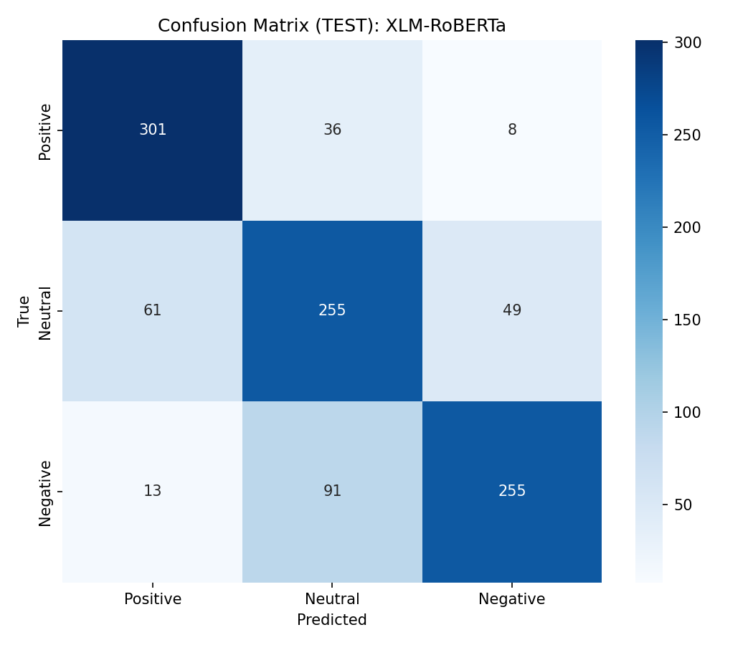
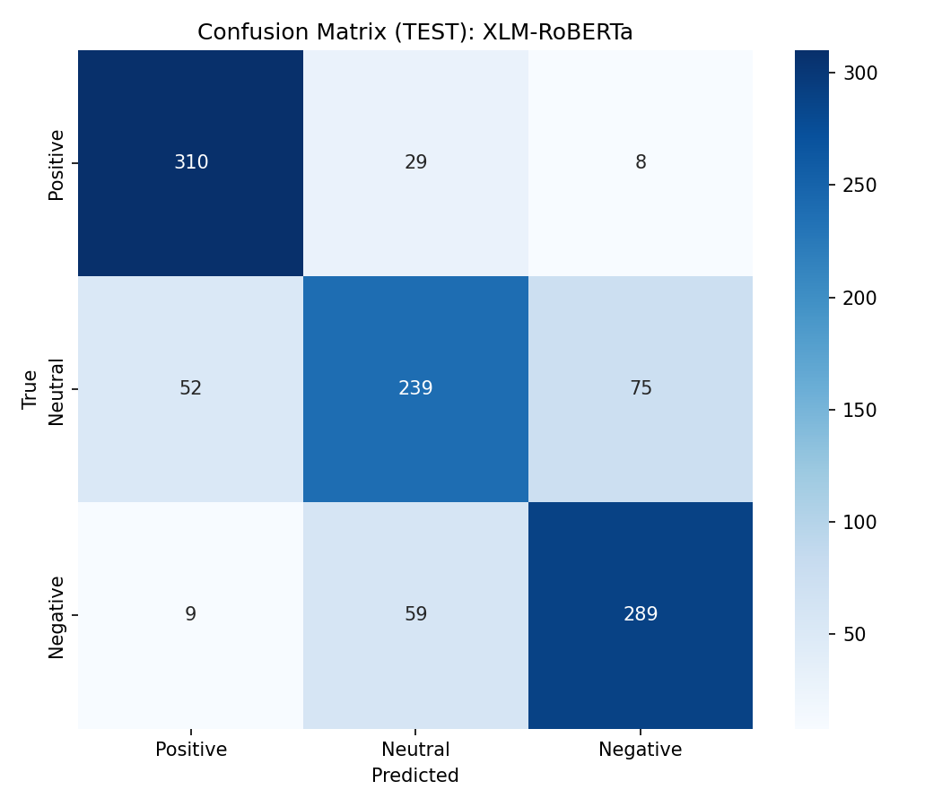
Confusion Matrix of Best Performing Models

Slide 22
Thank you.

